Slide 1
CS 463 Natural Language Processing
Dr. Saleh Haridy
2023-2024

Slide 2
N-gram Language Models

Slide 3
Probabilistic Language Models
The goal of probabilistic language model is to assign a probability to a sentence in
Machine Translation:
P(high winds tonight) > P(large winds tonight)
Spell Correction
The office is about fifteen minuets from my house
P(about fifteen minutes from) > P(about fifteen minuets from)
Speech Recognition
P(I saw a van) >> P(eyes awe of an)
+ Summarization, question-answering, etc., etc.!!
Models that assign probabilities to sequences of words are called language model LM

Slide 4
Probabilistic Language Modeling
Goal: compute the probability of a sentence or sequence of words:
P(W) = P(w₁,w₂,w₃,w₄,w₅…w_{n})
Related task: probability of an upcoming word:
P(w₅|w₁,w₂,w₃,w₄)
A model that computes either of these:
P(W) or P(w_{n}|w₁,w₂…w_{n-1}) is called a language model.
Better: the grammar But language model or LM is standard
How to compute the probability of a word w given some history h P(w|h).

Slide 5
How to compute P(W)
How to compute this joint probability:
P(its, water, is, so, transparent, that)
Intuition: let’s rely on the Chain Rule of Probability

Slide 6
Reminder: The Chain Rule
Recall the definition of conditional probabilities
p(B|A) = P(A,B)/P(A) Rewriting: P(A,B) = P(A)P(B|A)
More variables:
P(A,B,C,D) = P(A)P(B|A)P(C|A,B)P(D|A,B,C)
The Chain Rule in General
P(x₁,x₂,x₃,…,x_{n}) = P(x₁)P(x₂|x₁)P(x₃|x₁,x₂)…P(x_{n}|x₁,…,x_{n-1})

Slide 7
The Chain Rule applied to compute joint probability of words in sentence
P(“its water is so transparent”) =
P(its) × P(water|its) × P(is|its water)
× P(so|its water is) × P(transparent|its water is so)

Slide 8
How to estimate these probabilities
Could we just count and divide?
No! Too many possible sentences!
We’ll never see enough data for estimating these

Slide 9
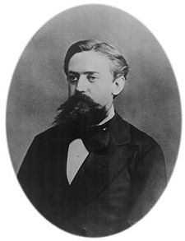
Markov Assumption
Simplifying assumption:
Or maybe
Andrei Markov

Slide 10
Markov Assumption
In other words, we approximate each component in the product

Slide 11
Simplest case: Unigram model
Some automatically generated sentences from a unigram model
fifth, an, of, futures, the, an, incorporated, a, a, the, inflation, most, dollars, quarter, in, is, mass
thrift, did, eighty, said, hard, 'm, july, bullish
that, or, limited, the

Slide 12
Bigram model
Condition on the previous word:
texaco, rose, one, in, this, issue, is, pursuing, growth, in, a, boiler, house, said, mr., gurria, mexico, 's, motion, control, proposal, without, permission, from, five, hundred, fifty, five, yen
outside, new, car, parking, lot, of, the, agreement, reached
this, would, be, a, record, november

Slide 13
N-gram models
We can extend to trigrams, 4-grams, 5-grams
In general this is an insufficient model of language
because language has long-distance dependencies:
“The computer which I had just put into the machine room on the fifth floor crashed.”
But we can often get away with N-gram models

Slide 14
Estimating bigram probabilities
The Maximum Likelihood Estimate

Slide 15

An example
<s> I am Sam </s>
<s> Sam I am </s>
<s> I do not like green eggs and ham </s>

Slide 16
More examples: Berkeley Restaurant Project sentences
can you tell me about any good cantonese restaurants close by
mid priced thai food is what i’m looking for
tell me about chez panisse
can you give me a listing of the kinds of food that are available
i’m looking for a good place to eat breakfast
when is caffe venezia open during the day

Slide 17
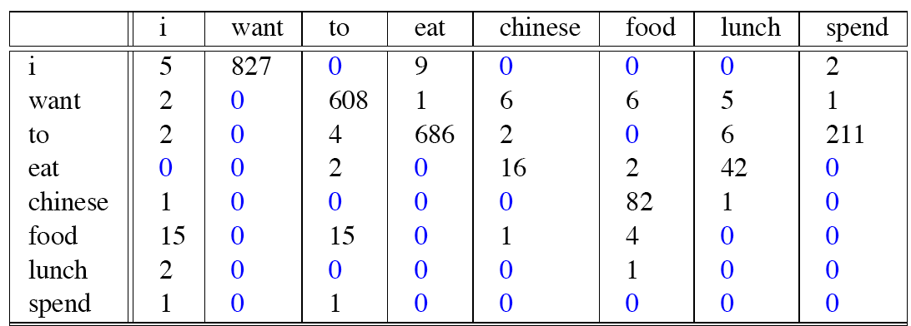
Raw bigram counts
Out of 9222 sentences

Slide 18
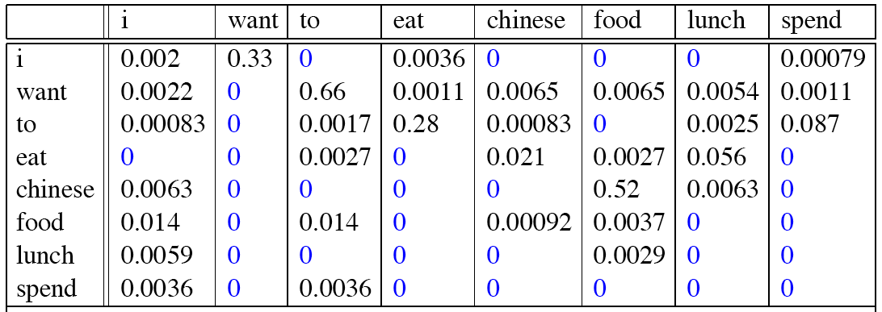
Raw bigram probabilities
Normalize by unigrams:
Result:

Slide 19
Bigram estimates of sentence probabilities
P(<s> I want english food </s>) =
P(I|<s>)
× P(want|I)
× P(english|want)
× P(food|english)
× P(</s>|food)
= .000031

Slide 20
What kinds of knowledge?
P(english|want) = .0011
P(chinese|want) = .0065
P(to|want) = .66
P(eat | to) = .28
P(food | to) = 0
P(want | spend) = 0
P (i | <s>) = .25

Slide 21
Practical Issues
We do everything in log space
Avoid underflow
(also adding is faster than multiplying)

Slide 22
Google N-Gram Release, August 2006
…

Slide 23
Google N-Gram Release
serve as the incoming 92
serve as the incubator 99
serve as the independent 794
serve as the index 223
serve as the indication 72
serve as the indicator 120
serve as the indicators 45
serve as the indispensable 111
serve as the indispensible 40
serve as the individual 234
http://googleresearch.blogspot.com/2006/08/all-our-n-gram-are-belong-to-you.html
http://ngrams.googlelabs.com/

Slide 24
Evaluation: How good is our model?
Does our language model prefer good sentences to bad ones?
Assign higher probability to “real” or “frequently observed” sentences
Than “ungrammatical” or “rarely observed” sentences?
We train parameters of our model on a training set.
We test the model’s performance on data we haven’t seen.
A test set is an unseen dataset that is different from our training set, totally unused.
An evaluation metric tells us how well our model does on the test set.

Slide 25
Extrinsic evaluation of N-gram models
Best evaluation for comparing models A and B
Put each model in a task
spelling corrector, speech recognizer, MT system
Run the task, get an accuracy for A and for B
How many misspelled words corrected properly
How many words translated correctly
Compare accuracy for A and B

Slide 26
Difficulty of extrinsic (in-vivo) evaluation of N-gram models
Extrinsic evaluation
Time-consuming; can take days or weeks
So
Sometimes use intrinsic evaluation: perplexity
Bad approximation
unless the test data looks just like the training data
So generally only useful in pilot experiments
But is helpful to think about.

Slide 27
Intuition of Perplexity
The Shannon Game:
How well can we predict the next word?
Unigrams are terrible at this game. (Why?)
A better model of a text
is one which assigns a higher probability to the word that actually occurs
mushrooms 0.1
pepperoni 0.1
anchovies 0.01
….
fried rice 0.0001
….
and 1e-100
I always order pizza with cheese and ____
The 33rd President of the US was ____
I saw a ____

Slide 28
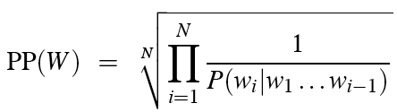
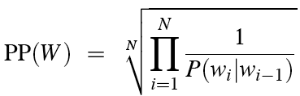
Perplexity
The best language model is one that best predicts an unseen test set
Gives the highest P(sentence)
Perplexity is the inverse probability of the test set, normalized by the number of words:
Chain rule:
For bigrams:
Minimizing perplexity is the same as maximizing probability

Slide 29
The Shannon Game intuition for perplexity
From Josh Goodman
Perplexity is weighted equivalent branching factor
How hard is the task of recognizing digits ‘0,1,2,3,4,5,6,7,8,9’
Perplexity 10
How hard is recognizing (30,000) names at Microsoft.
Perplexity = 30,000
Let's imagine a call-routing phone system gets 120K calls and has to recognize
"Operator" (let's say this occurs 1 in 4 calls)
"Sales" (1in 4)
"Technical Support" (1 in 4)
30,000 different names (each name occurring 1 time in the 120K calls)
What is the perplexity? Next slide

Slide 30
The Shannon Game intuition for perplexity
Josh Goodman: imagine a call-routing phone system gets 120K calls and has to recognize
"Operator" (let's say this occurs 1 in 4 calls)
"Sales" (1in 4)
"Technical Support" (1 in 4)
30,000 different names (each name occurring 1 time in the 120K calls)
We get the perplexity of this sequence of length 120Kby first multiplying 120K probabilities (90K of which are 1/4 and 30K of which are 1/120K), and then taking the inverse 120,000th root:
Perp = (¼ * ¼ * ¼* ¼ * ¼ * …. * 1/120K * 1/120K * ….)^(-1/120K)
But this can be arithmetically simplified to just N = 4: the operator (1/4), the sales (1/4), the tech support (1/4), and the 30,000 names (1/120,000):
Perplexity= ((¼ * ¼ * ¼ * 1/120K)^(-1/4) = 52.6

Slide 31
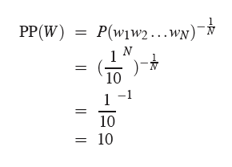
Perplexity as branching factor
Let’s suppose a sentence consisting of random digits
What is the perplexity of this sentence according to a model that assign P=1/10 to each digit?

Slide 32
Lower perplexity = better model
Training 38 million words, test 1.5 million words, Wall Street Journal
N-gram Order | Unigram | Bigram | Trigram
Perplexity | 962 | 170 | 109

Slide 33
The Shannon Visualization Method
In most cases probability of bigram and trigram are zeros, What we should do in these cases?
Choose a random bigram
(<s>, w) according to its probability
Now choose a random bigram (w, x) according to its probability
And so on until we choose </s>
Then string the words together
<s> I
I want
want to
to eat
eat Chinese
Chinese food
food </s>
I want to eat Chinese food
This is how a sentence is generated from bigram model

Slide 34
Approximating Shakespeare
This is a generated sentence from a model trained on Shakespeare stories.

Slide 35
Shakespeare as corpus
N=884,647 tokens, V=29,066
Shakespeare produced 300,000 bigram types out of V²= 844 million possible bigrams.
So 99.96% of the possible bigrams were never seen (have zero entries in the table)
Quadrigrams worse: What's coming out looks like Shakespeare because it is Shakespeare

Slide 36
The Wall Street Journal is tested on Shakespeare corpus
N-grams only work well for word prediction if the test corpus simmilar to training corpus.
How to generalize the model

Slide 37
The dangers of overfitting
N-grams only work well for word prediction if the test corpus looks like the training corpus
In real life, it often doesn’t
We need to train robust models that generalize!
One kind of generalization: Zeros!
Things that don’t ever occur in the training set
But occur in the test set

Slide 38
Zeros
Example
The training set used to train the model:
… denied the allegations
… denied the reports
… denied the claims
… denied the request
What happen when we test this:
P(“offer” | denied the) = 0
Test set
… denied the offer
… denied the loan
If we build a MT based on this model, the MT will refuse these sentences because it did not appear in the training

Slide 39
Zero probability bigrams
Bigrams with zero probability
mean that we will assign 0 probability to the test set!
And hence we cannot compute perplexity (can’t divide by 0)!
Solution is
Smoothing: Add-one (Laplace) smoothing

Slide 40
The intuition of smoothing (from Dan Klein)
When we have sparse statistics:
Steal probability mass to generalize better
P(w | denied the)
3 allegations
2 reports
1 claims
1 request
7 total
allegations
attack
man
reports
outcome
…
claims
request
P(w | denied the)
2.5 allegations
1.5 reports
0.5 claims
0.5 request
2 other
7 total
allegations
allegations
attack
man
outcome
reports
…
claims
request

Slide 41
Add-one estimation(Laplace smoothing)
Pretend we saw each word one more time than we did
Just add one to all the counts!
MLE estimate:
Add-1 estimate:

Slide 42
Maximum Likelihood Estimates
The maximum likelihood estimate
of some parameter of a model M from a training set T
maximizes the likelihood of the training set T given the model M
Suppose the word “fun” occurs 400 times in a corpus of a million words
What is the probability that a random word from some other text will be “fun”?
MLE estimate is 400/1,000,000 = .0004
This may be a bad estimate for some other corpus
But it is the estimate that makes it most likely that “fun” will occur 400 times in a million word corpus.

Slide 43
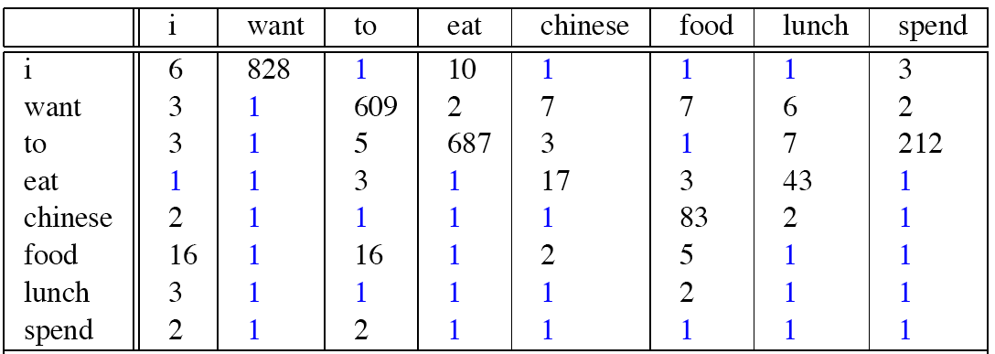
Berkeley Restaurant Corpus: Laplace smoothed bigram counts

Slide 44

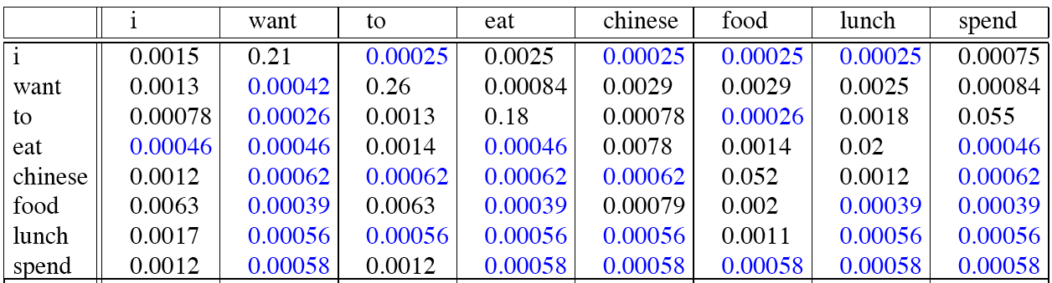
Laplace-smoothed bigrams

Slide 45
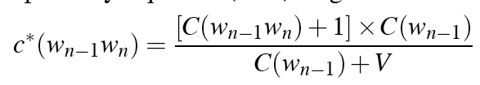
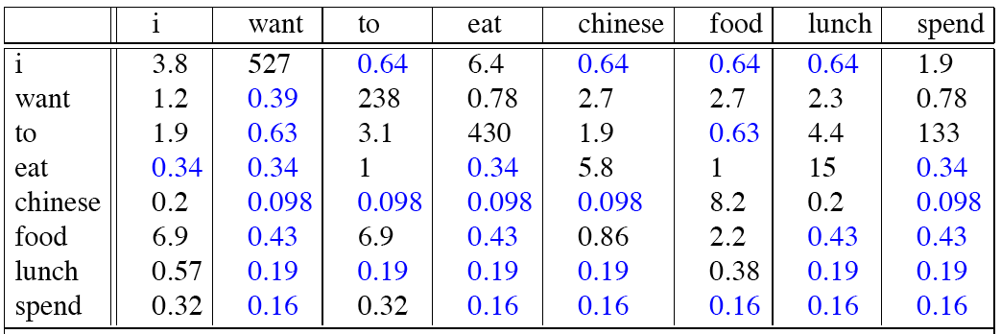
Reconstituted counts
Take previous probabilities and reconstitute the counts imagining that we see these bigrams

Slide 46
Compare with raw bigram counts
Original counts
Reconstituted counts
Notes:
C(want to) went from 608 to 238, P(to|want) from .66 to .26!
Discount d= c*/c
d for “chinese food” =.10!!! A 10x reduction

Slide 47
Add-1 estimation is not accurate estimator
So add-1 isn’t used for N-grams:
We’ll see better methods
But add-1 is used to smooth other NLP models
For text classification
In domains where the number of zeros isn’t so huge.
Interpolation, Backoff, and Web-Scale LMs

Slide 48
Backoff and Interpolation
Sometimes it helps to use less context (just switch between 1-gram, 2-gram, 3-gram)
Condition on less context for contexts you haven’t learned much about
Backoff:
use trigram if you have good evidence,
otherwise bigram, otherwise unigram
Or use Interpolation:
mix unigram, bigram, trigram
Interpolation works better

Slide 49
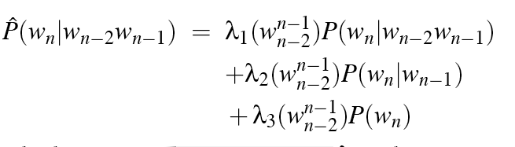
Linear Interpolation
Simple interpolation
Lambdas conditional on context:

Slide 50
How to set the lambdas?
Validation data
Use a held-out corpus
Choose λs to maximize the probability of held-out data:
Fix the N-gram probabilities (on the training data)
Then search for λs that give largest probability to held-out set:
Training Data
Held-Out Data
Test
Data

Slide 51
Unknown words: Open versus closed vocabulary tasks
If we know all the words in advanced
Vocabulary V is fixed
Closed vocabulary task
Often we don’t know this
Out Of Vocabulary = OOV words
Open vocabulary task
Instead: create an unknown word token <UNK>
Training of <UNK> probabilities
Create a fixed lexicon L of size V
At text normalization phase, any training word not in L changed to <UNK>
Now we train its probabilities like a normal word
At decoding time
If text input: Use UNK probabilities for any word not in training

Slide 52
Huge web-scale n-grams
How to deal with, e.g., Google N-gram corpus
Pruning
Only store N-grams with count > threshold.
Remove singletons of higher-order n-grams
Entropy-based pruning
Efficiency
Efficient data structures like tries
Bloom filters: approximate language models
Store words as indexes, not strings
Use Huffman coding to fit large numbers of words into two bytes
Quantize probabilities (4-8 bits instead of 8-byte float)

Slide 53
Smoothing for Web-scale N-grams
“Stupid backoff algorithm” (Brants et al. 2007)
No discounting, just use relative frequencies

Slide 54
N-gram Smoothing Summary
Add-1 smoothing:
Good for text categorization, not for language modeling
The most commonly used method:
Extended Interpolated Kneser-Ney
For very large N-grams like the Web:
Stupid backoff
Advanced:
Kneser-Ney Smoothing

Slide 55
Absolute discounting: just subtract a little from each count
Suppose we wanted to subtract a little from a count of 4 to save probability mass for the zeros
How much to subtract ?
Church and Gale (1991)’s clever idea
Divide up 22 million words of AP Newswire
Training and held-out set
for each bigram in the training set
see the actual count in the held-out set!
It sure looks like c* = (c - .75)
Bigram count in training | Bigram count in heldout set
0 | .0000270
1 | 0.448
2 | 1.25
3 | 2.24
4 | 3.23
5 | 4.21
6 | 5.23
7 | 6.21
8 | 7.21
9 | 8.26

